Slide 1
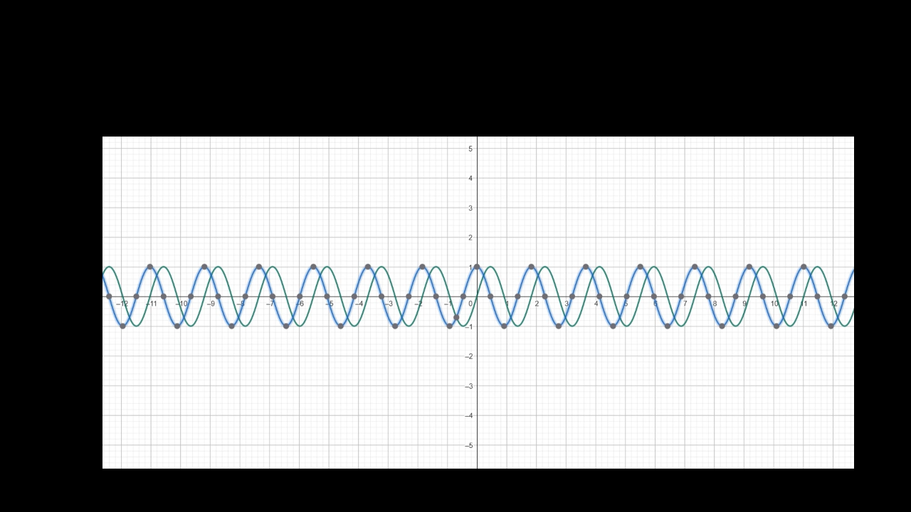
POWER SERIES

Slide 2
POWER SERIES
POWER SERIES ARE ONE OF THE MOST USEFUL TYPE OF SERIES IN ANALYSIS. WE CAN USE THEM TO DEFINE TRANSCENDENTAL FUNCTIONS SUCH AS THE EXPONENTIAL AND TRIGONOMETRIC FUNCTIONS

Slide 3
POWER SERIES
POWER SERIES ARE ONE OF THE MOST USEFUL TYPE OF SERIES IN ANALYSIS. WE CAN USE THEM TO DEFINE TRANSCENDENTAL FUNCTIONS SUCH AS THE EXPONENTIAL AND TRIGONOMETRIC FUNCTIONS
POWER SERIES ARE USEFUL IN MATHEMATICAL ANALYSIS, WHERE THEY ARISE AS TAYLOR SERIES OF INFINITELY DIFFERENTIABLE FUNCTIONS. IN FACT, BOREL’S THEOREM IMPLIES THAT EVERY POWER SERIES IS THE TAYLOR SERIES OF SOME SMOOTH FUNCTION.

Slide 4
POWER SERIES
POWER SERIES ARE ONE OF THE MOST USEFUL TYPE OF SERIES IN ANALYSIS. WE CAN USE THEM TO DEFINE TRANSCENDENTAL FUNCTIONS SUCH AS THE EXPONENTIAL AND TRIGONOMETRIC FUNCTIONS
POWER SERIES ARE USEFUL IN MATHEMATICAL ANALYSIS, WHERE THEY ARISE AS TAYLOR SERIES OF INFINITELY DIFFERENTIABLE FUNCTIONS. IN FACT, BOREL’S THEOREM IMPLIES THAT EVERY POWER SERIES IS THE TAYLOR SERIES OF SOME SMOOTH FUNCTION.
THE PARTIAL SUMS OF A POWER SERIES ARE POLYNOMIALS , THE PARTIAL SUMS OF THE TAYLOR SERIES OF AN ANALYTIC FUNCTION ARE A SEQUENCE OF CONVERGING POLYNOMIAL APPROXIMATIONS TO THE FUNCTION AT THE CENTER.

Slide 5
POWER SERIES
POWER SERIES ARE ONE OF THE MOST USEFUL TYPE OF SERIES IN ANALYSIS. WE CAN USE THEM TO DEFINE TRANSCENDENTAL FUNCTIONS SUCH AS THE EXPONENTIAL AND TRIGONOMETRIC FUNCTIONS
POWER SERIES ARE USEFUL IN MATHEMATICAL ANALYSIS, WHERE THEY ARISE AS TAYLOR SERIES OF INFINITELY DIFFERENTIABLE FUNCTIONS. IN FACT, BOREL’S THEOREM IMPLIES THAT EVERY POWER SERIES IS THE TAYLOR SERIES OF SOME SMOOTH FUNCTION.
THE PARTIAL SUMS OF A POWER SERIES ARE POLYNOMIALS , THE PARTIAL SUMS OF THE TAYLOR SERIES OF AN ANALYTIC FUNCTION ARE A SEQUENCE OF CONVERGING POLYNOMIAL APPROXIMATIONS TO THE FUNCTION AT THE CENTER.
A CONVERGING POWER SERIES CAN BE SEEN AS A KIND OF GENERALIZED POLYNOMIAL WITH INFINITELY MANY TERMS. CONVERSELY, EVERY POLYNOMIAL IS A POWER SERIES WITH ONLY FINITELY MANY NON-ZERO TERMS.

Slide 6


A power series (centered at 0) is a series of the form
$$\sum_{n=0}^{∞}{a_{n}}x^{n}=a_{0}+a_{1}x+a_{2}x^{2}+…+a_{n}x^{n}+…$$
where (${a_{n})}_{n=0}^{∞}$ is a sequence of real numbers.
The more general form of power series is given as:
$$\sum_{n=0}^{∞}{a_{n}}{\left(x−c\right)}^{n}$$
where c is a fixed real number, but they reduce to series of the
form
$\sum_{n=0}^{∞}{a_{n}y^{n}}$
by the change of variable y = x − c.
The interval of convergence for this series will be an interval centered at c instead of 0.

Slide 7

Theorem:
For the power series $\sum{a_{n}x^{n} }$, let
β= limsup${\left|a_{n}\right|}^{\frac{1}{n}}$ & R= $\frac{1}{\text{β}}.$
[If β = 0 we set R =+$∞$, and if β = +$∞$ we set R = 0.] Then,
(i) The power series converges for |x| < R;
(ii) The power series diverges for |x| > R.
R is called the radius of convergence for the power series.
Note that (i) is a vacuous statement if R = 0 and that (ii) is a vacuous statement if R = +$∞$.
(a) The power series converges for all x ∈ $ℝ$, when R= +$∞$.
(b) The power series converges only for x = 0, when R=0.
(c) The power series converges for all x in some bounded interval
centered at 0( the interval may be open, half-open or closed), when 0<R< +$∞.$

Slide 8

Proof:
For each x ∈ $ℝ$, let $α_{x}$ = limsup${\left|a_{n}x^{n}\right|}^{\frac{1}{n}}=$limsup$\left|x\right|{\left|a_{n}\right|}^{\frac{1}{n}}=\left|x\right|.$limsup${\left|a_{n}\right|}^{\frac{1}{n}}=\text{β}\left|x\right|$
Case 1. Suppose 0 <R< +$∞$ In this case $α_{x}$ = β|x| =$\frac{\left|x\right|}{R}$.
If |x| < R then $α_{x}$ < 1, so the series converges by the Root Test.
Likewise, if |x| > R, then $α_{x}$ > 1 and the series diverges.
Case 2. Suppose R = +$∞$Then β = 0 and $α_{x}$ = 0 no matter what x is. Hence the power series converges for all x .
Case 3. Suppose R = 0. Then β = +$∞$and $α_{x}$ = +$∞$ for $x≠0.$
Thus by the Root Test the series diverges for $x≠0.$
(if lim $\left|\frac{a_{n+1}}{a_{n}}\right|$exists, then this limit equals β)

Slide 9
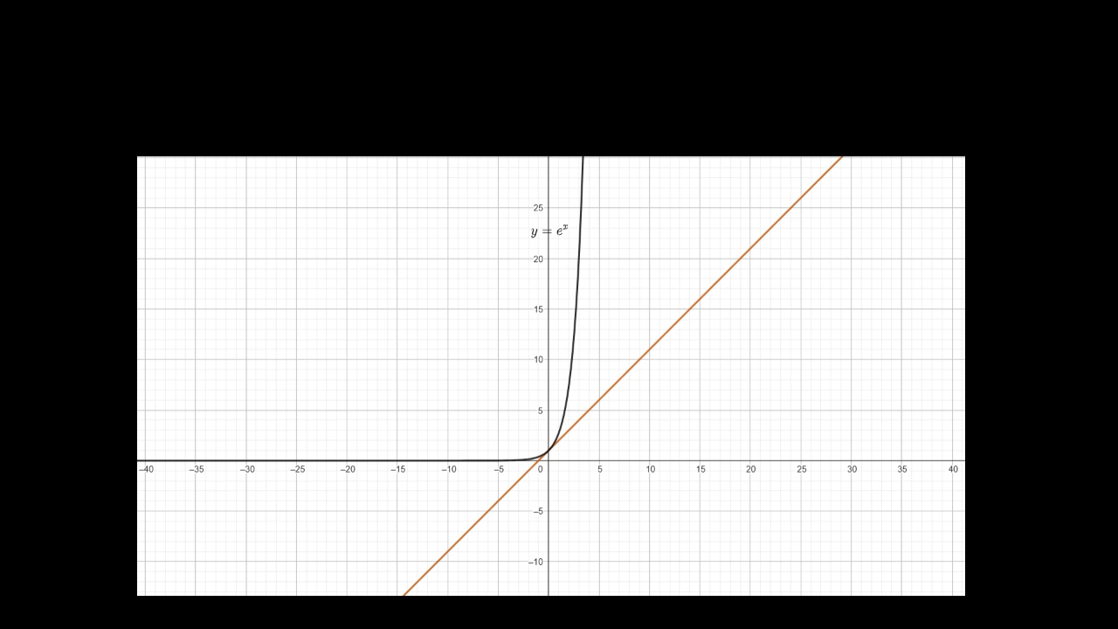

Consider
$\sum_{n=0}^{∞}{\frac{x^{n}}{n!} }$
$⇒$Here $a_{n=}\frac{1}{n! }$ , so $\frac{a_{n+1}}{a_{n}}= \frac{1}{n+1}$ , so,
$\lim_{n→∞}\left|\frac{a_{n+1}}{a_{n}}\right|$=0
Therefore β = 0, R = + $∞$ and this series has radius of convergence
$+∞.$That is, it converges for all x in $ℝ.$ In fact, it converges to $e^{x}$ for all x(Taylor series).

Slide 10
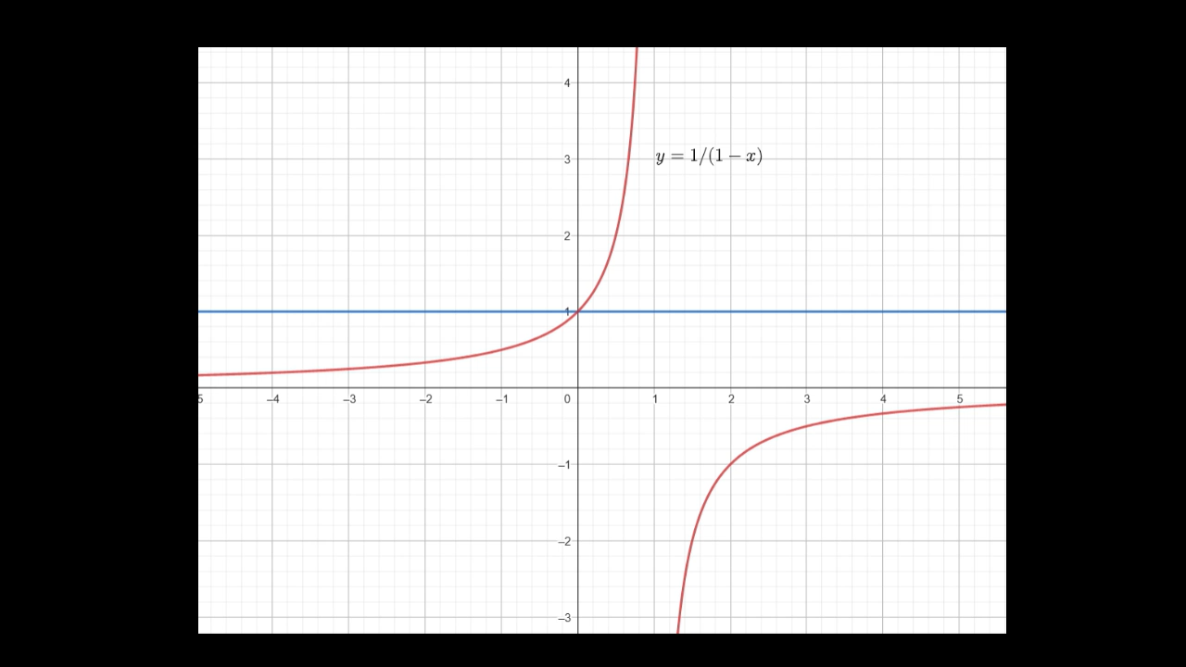

Consider
$$\sum_{n=0}^{∞}{x^{n}}$$
$⇒$Here β = 1 and R = 1.
This series does not converge for x = 1 or x = −1, so the interval of convergence is exactly (−1, 1) and the series converges to 1/(1-x) by infinite sum of a geometric series.

Slide 11
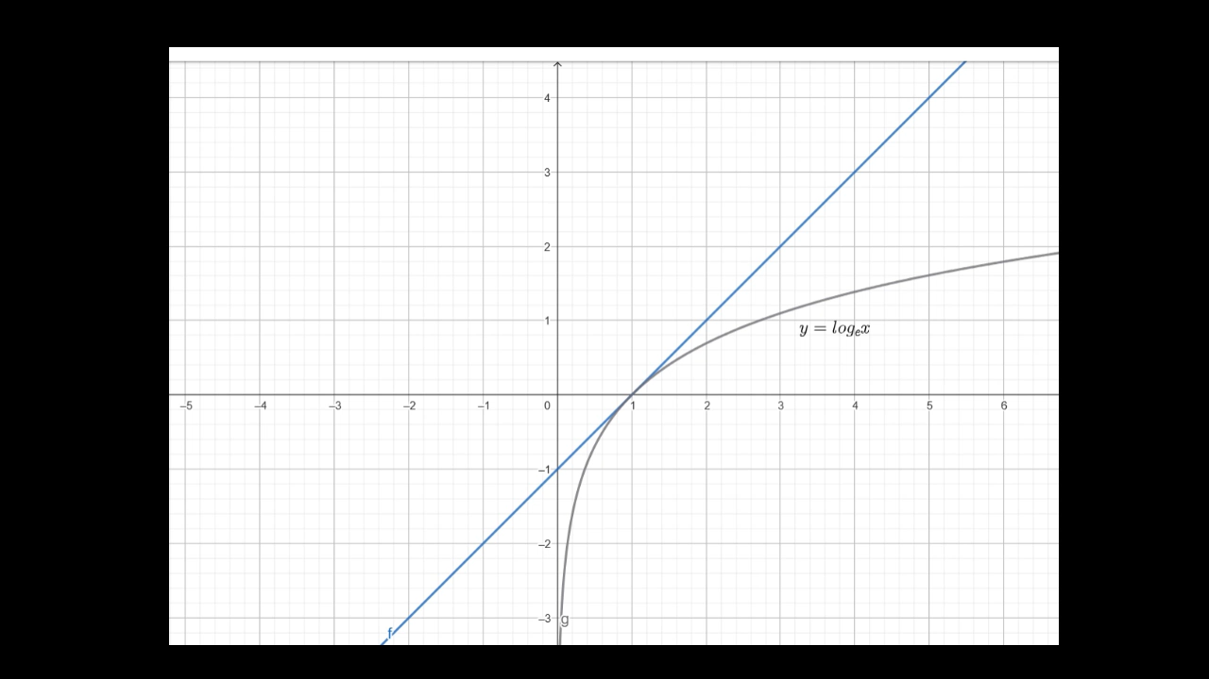
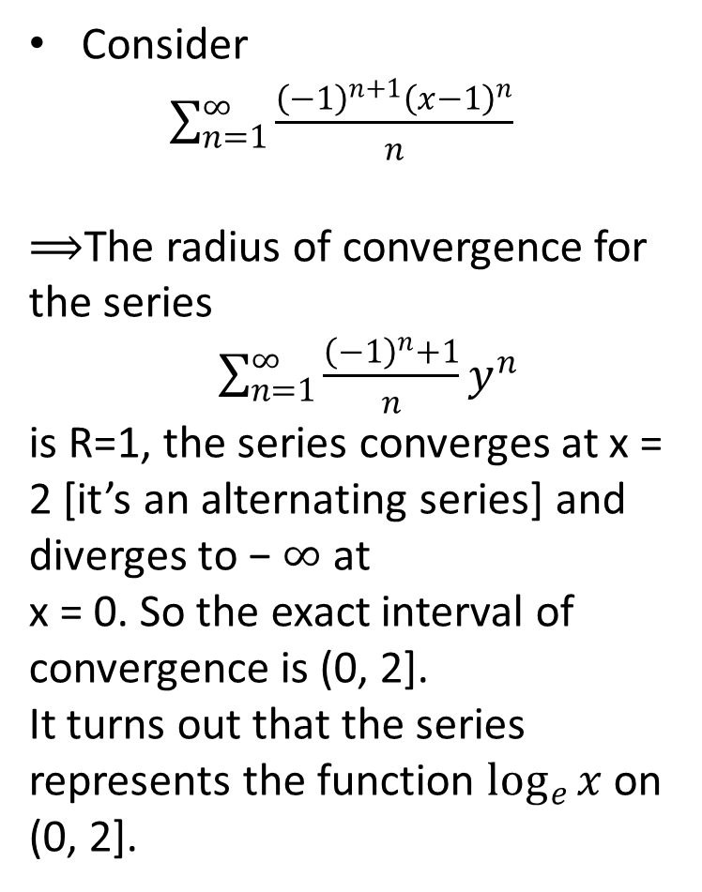
Consider
$\sum_{n=1}^{∞}{\frac{{\left(−1\right)}^{n+1}{\left(x−1\right)}^{n}}{n}}$
$⟹$The radius of convergence for the series
$\sum_{n=1}^{∞}{\frac{{\left(−1\right)}^{n}+1}{n}y^{n}}$
is R=1, the series converges at x = 2 [it’s an alternating series] and diverges to − $∞$ at
x = 0. So the exact interval of convergence is (0, 2].
It turns out that the series represents the function $\log_{e}{x }$on (0, 2].

Slide 12
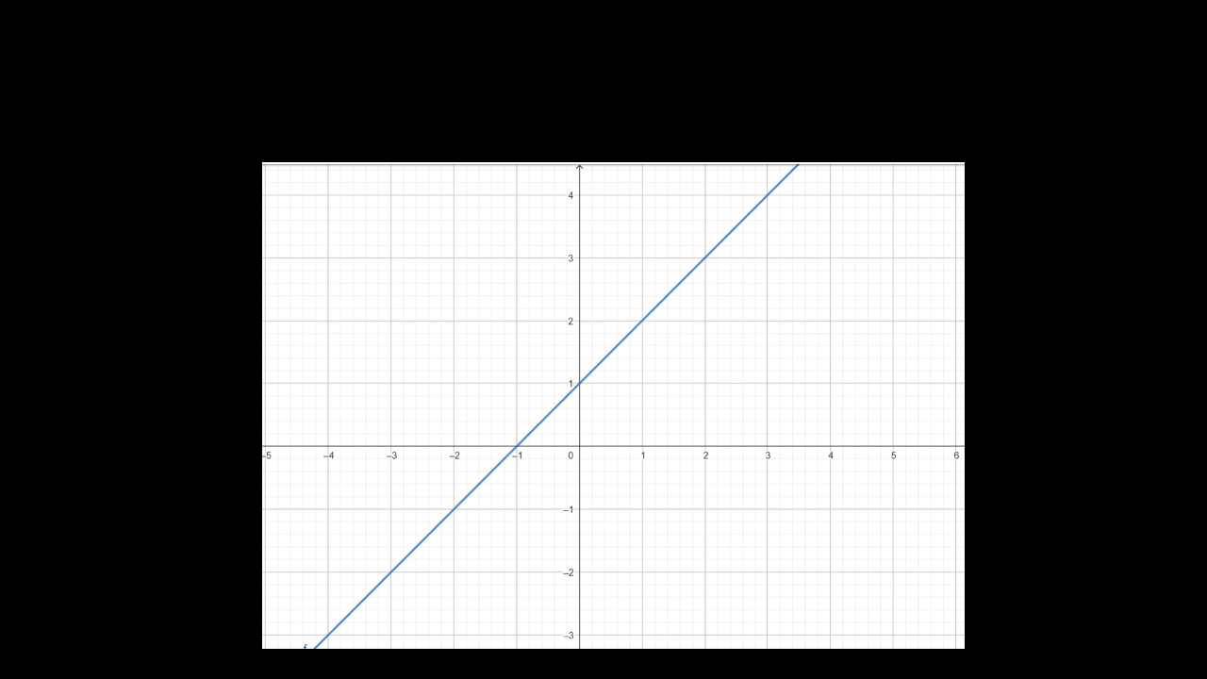
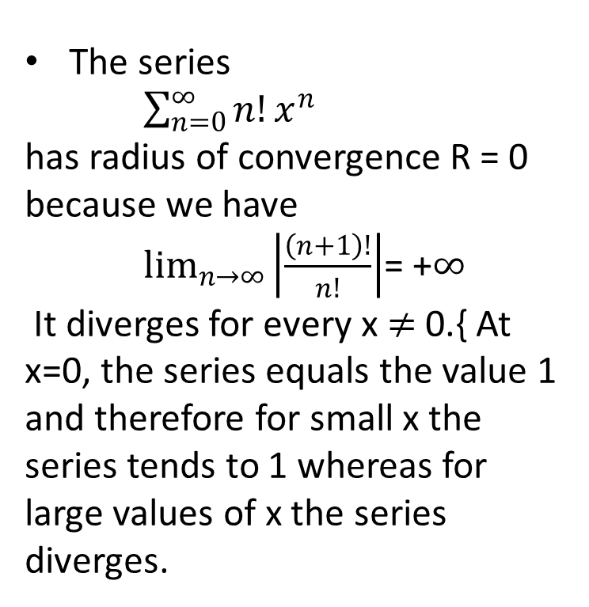
The series
$\sum_{n=0}^{∞}{n!x^{n}}$
has radius of convergence R = 0 because we have
$\lim_{n→∞}\left|\frac{\left(n+1\right)!}{n!}\right|$= +$∞$
It diverges for every x $≠$ 0.{ At x=0, the series equals the value 1 and therefore for small x the series tends to 1 whereas for large values of x the series diverges.

Slide 13
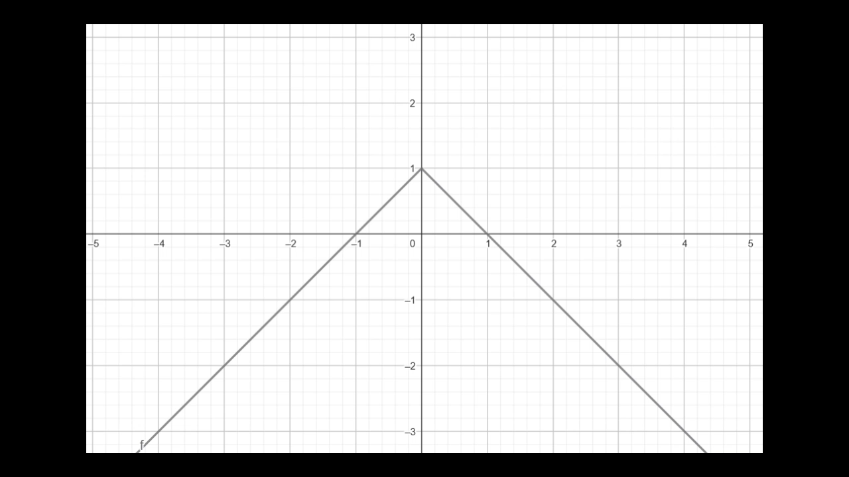
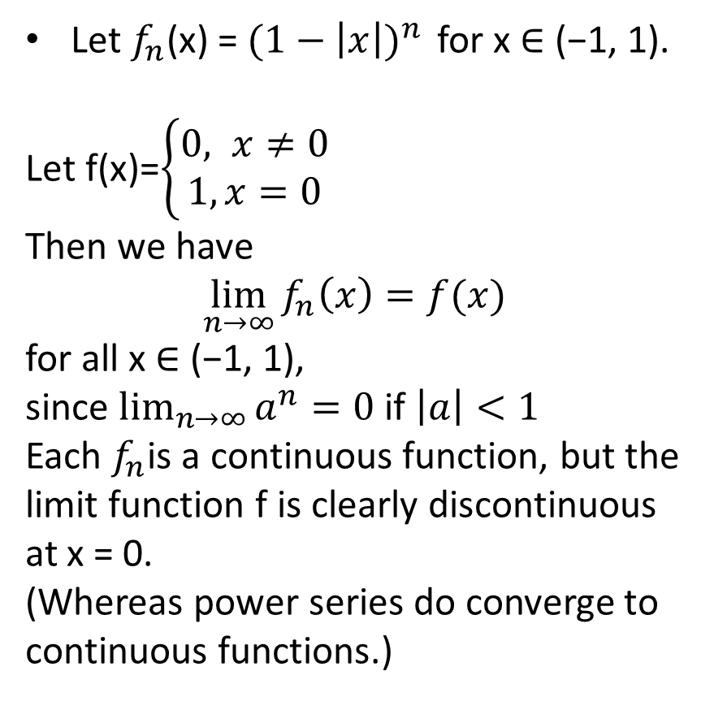
Let $f_{n}$(x) = ${(1−\left|x\right|)}^{n }$ for x ∈ (−1, 1).
Let f(x)=$\left\{\begin{aligned}0, x≠0 \\ 1,x=0\end{aligned}\right.$
Then we have
$$\lim_{n→∞}{f_{n}\left(x\right)=f(x)}$$
for all x ∈ (−1, 1),
since $\lim_{n→∞}{a^{n}=0 }$if $\left|a\right|<1$
Each $f_{n}$is a continuous function, but the limit function f is clearly discontinuous
at x = 0.
(Whereas power series do converge to continuous functions.)

